Slide 1
Controller Area Network (CAN bus)
Prepared by:
Kazi Shadman Sakib
FH-97
3rd Year
Computer Science and Engineering, University of Dhaka

Slide 2
What is Controller Area Network (CAN bus) ?
The Controller Area Network (CAN) is a serial communication bus designed to allow microcontrollers and devices to communicate with each other within a vehicle without a host computer which allows for control and data acquisition.
CAN was developed to reduce cable wiring, so the separate electronic control units (ECUs) inside a vehicle could communicate with only a single pair of wires.

Slide 3
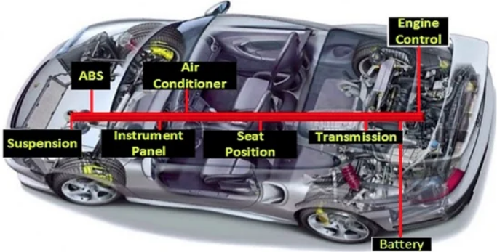
How does the CAN Bus looks like?

Slide 4
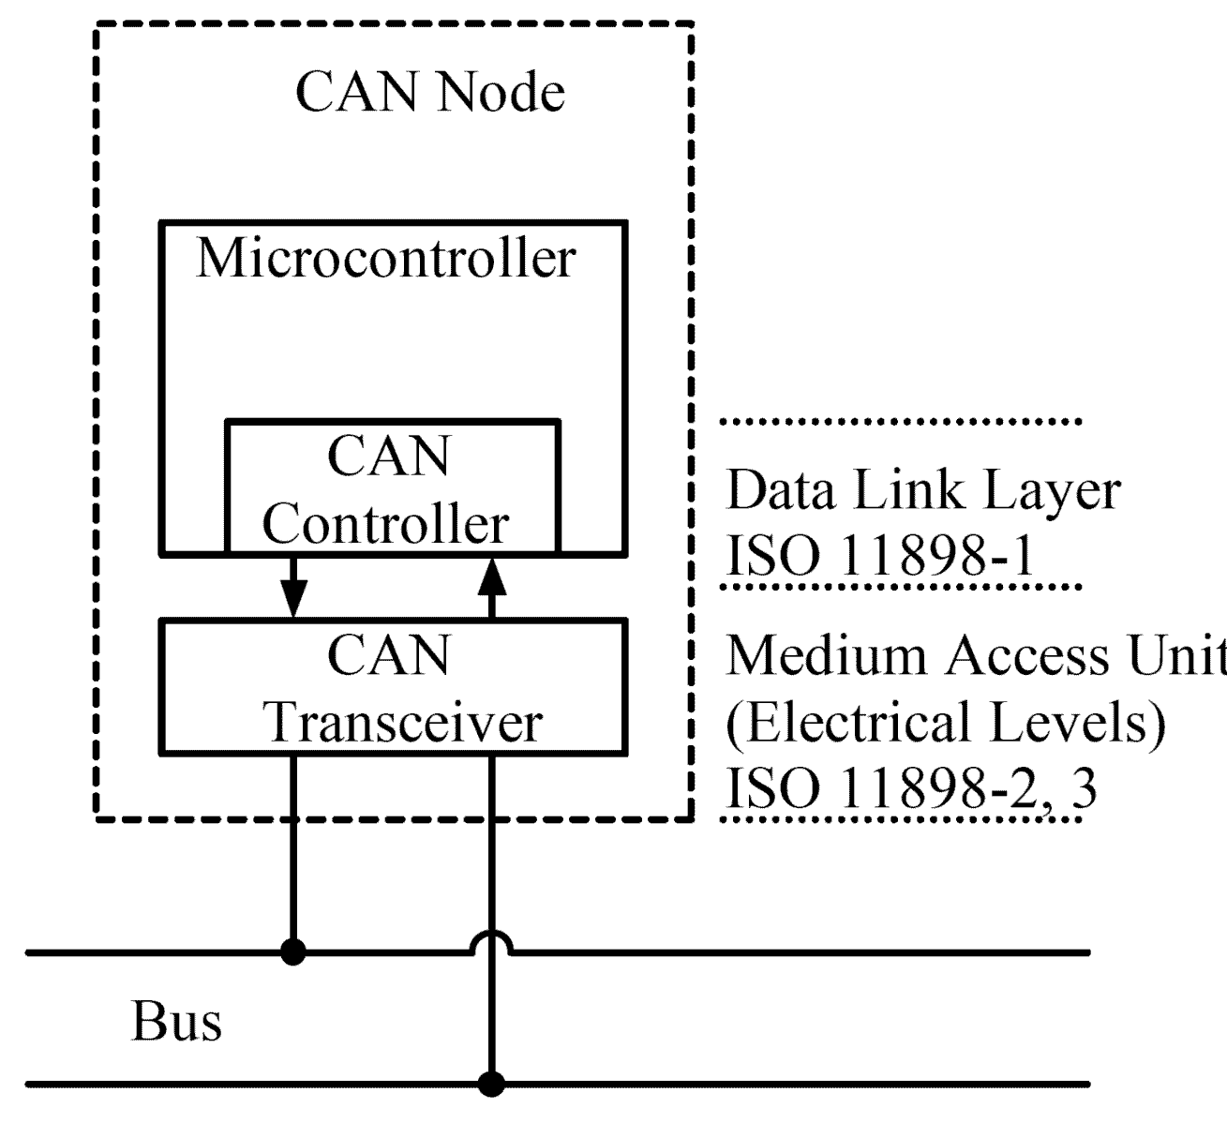
What Is the CAN Bus Protocol?
Can Bus is a message-based protocol.
Designed to allow the Electronic Control Units to communicate.
With CAN, all data are sent in frames, and there are four types:
Data frames transfer data to one or many receiver nodes
Remote frames ask for data from other nodes
Error frames report errors
Overload frames report overload conditions

Slide 5
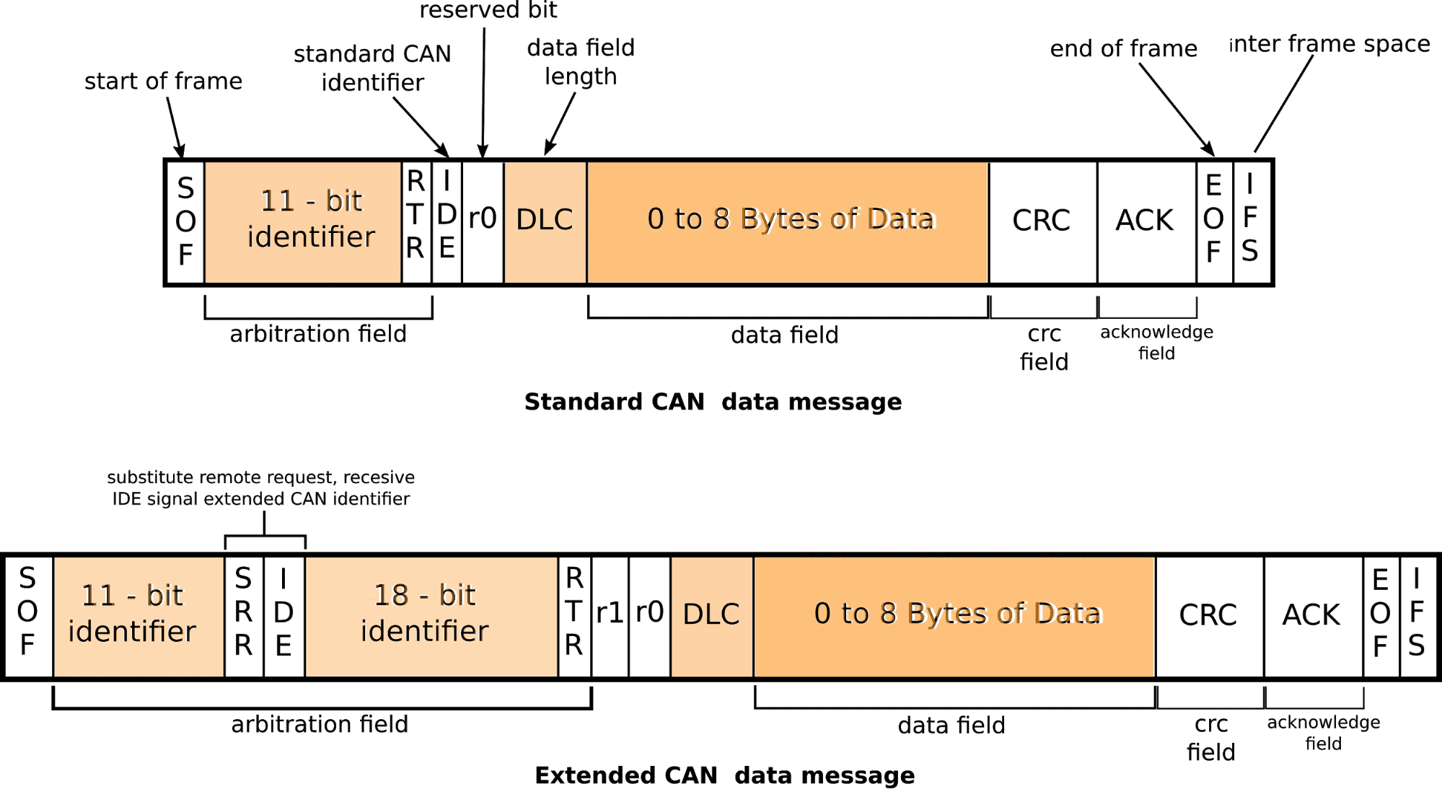
Frame Structure of CAN Protocol

Slide 6
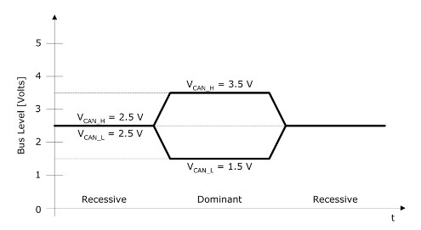
CAN Bus Arbitration
Can Bus is divided into two categories:
CAN_H (CAN HIGH)
CAN_L (CAN LOW)
CAN_H and CAN_L at the same voltage level means logical 1 and its called Recessive state.
CAN_H and CAN_L offsetted by 1 volt means logical 0 and its called Dominant state.
Higher priority -> Dominant state.
Lower priority -> Recessive state.

Slide 7
CAN Bus Arbitration contd.
Every bit that a node transmits, it monitors.
Dominant states gets the higher priority
The moment a node sends a recessive bit but detects a dominant bit on the bus, it backs off.
Problem arises when multiple nodes try to transmit at the same time. But this arbitration solves the simultaneous transmission issue for the multiple device controls.

Slide 8
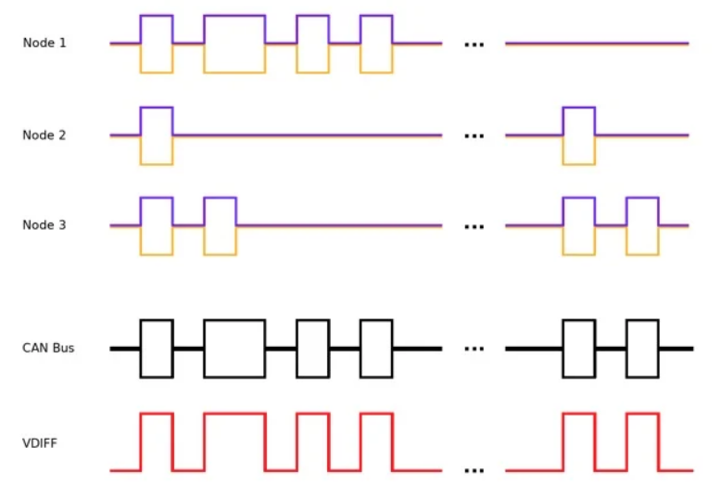
CAN Bus Arbitration contd.

Slide 9
Advantages of CAN Bus
Simple and Low Cost
Fully Centralized
Efficient
Reduced Vehicle Weight
Easy Deployment

Slide 10
Conclusion
CAN is a robust serial communication bus found mostly in automotive and industrial environments.
CAN uses a differential signal, which makes it more resistant to noise, along with a priority arbitration scheme for non-destructive message transmission.
CAN is great for embedded applications that end up in hazardous environments or areas with a lot of electromagnetic interference. Whether you're building a remote-controlled submarine, setting up a microbrewery with pumps and sensors, or just hacking your car's computer, CAN is a great way to further your embedded knowledge while beefing up your next design project.

Slide 11
Thank you, Sir.

